Slide 1
Modelling COVID-19 – Analysis and Visualisation
Hedi Smiri - GLSI3

Slide 2
Plan
Introduction
Definition :
Artificial Intelligence
Machine Learning
Approach
Excremental Results :
Visualization Diagrams
Evaluation
Conclusion

Slide 3

Introduction :
In this Presentation I will show how to inspect the data, represent it on chart and model future epidemic trends with Python, using some open source data science libraries such as Pandas, Matplotlib and Scikit-learn.
First let Define Some Words Used :
Artificial intelligence :
What is The Artificial intelligence :
Artificial intelligence is the simulation of human intelligence processes by machines, especially computer systems. Specific applications of AI include expert systems, natural language processing, speech recognition and machine vision.

Slide 4
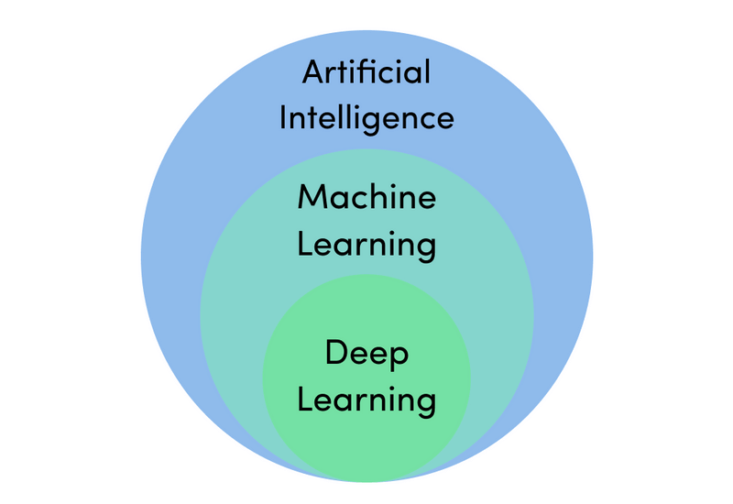
The subfield Of Artificiel Intelligence

Slide 5
Machine Learning
What is The Machine Learning :
Machine Learning (ML) is The science of automate a task using some autonomous bots created by several programming languages (python, C++, Java, R, LISP ... and many others )
What is The Types of Machine Learning :
-Supervised Learning
-Unsupervised Learning
-Reinforcement Learning
Common Machine Learning Algorithms :
Linear Regression -Random Forest
Logistic Regression -Gradient Boosting algorithms -K-Means
Decision Tree -Naive Bayes
SVM -kNN
Dimensionality Reduction Algorithms

Slide 6
Deep Learning
What is Deep Learning:
Deep Learning is a subset of Machine Learning, which on the other hand is a subset of Artificial Intelligence. Artificial Intelligence is a general term that refers to techniques that enable computers to mimic human behavior. Machine Learning represents a set of algorithms trained on data that make all of this possible
Deep Learning, on the other hand, is just a type of Machine Learning, inspired by the structure of a human brain. Deep learning algorithms attempt to draw similar conclusions as humans would by continually analyzing data with a given logical structure. To achieve this, deep learning uses a multi-layered structure of algorithms called neural networks.

Slide 7
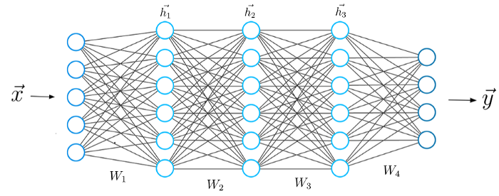
A typical Neural Network.

Slide 8
Problem
The COVID-19 pandemic has presented a series of new challenges to governments and health care systems. Testing is one important method for monitoring and therefore controlling the spread of COVID-19. Yet with a serious discrepancy in the resources available between rich and poor countries not every country is able to employ widespread testing. Here we developed machine learning models for predicting the number of COVID-19 cases in all country based on Linear Regression Classifier using Sklearn

Slide 9
Approach
Linear Regression
DecsionTree
Naïve Bayes

Slide 10
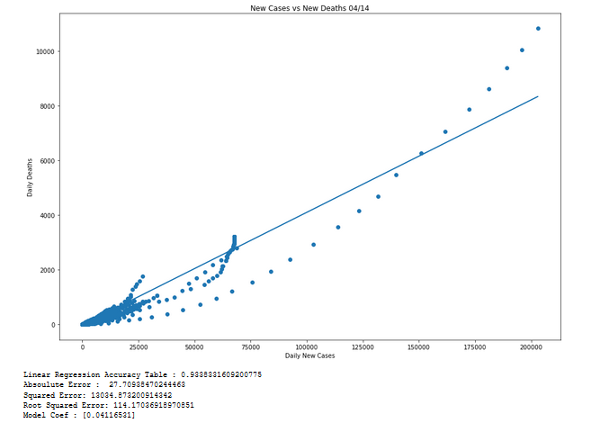
New Cases and New Death

Slide 11
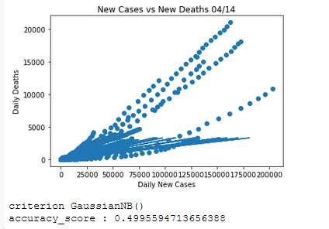
New Cases and New Death

Slide 12
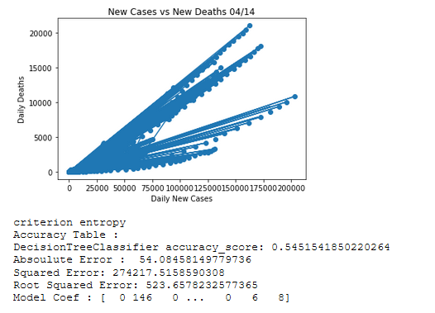
New Cases and New Death

Slide 13
Evaluation
In Our Presentation We Are testing 3 Model Based at this dataset
Linear Regression
Naïve Bayes
DecsionTree
We Conclude In our case, the best model based on visualization, accuracy and error_rate is Linear Regression Model .

Slide 14
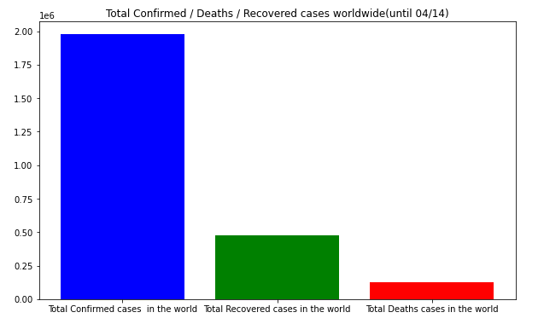

Slide 15
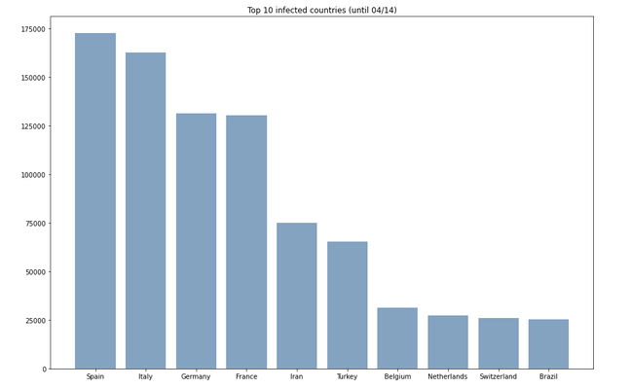

Slide 16
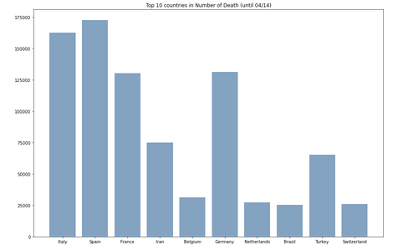

Slide 17
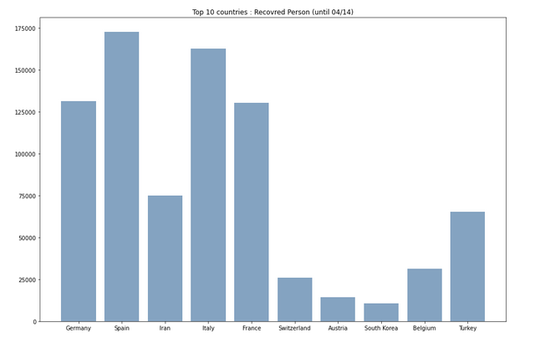

Slide 18
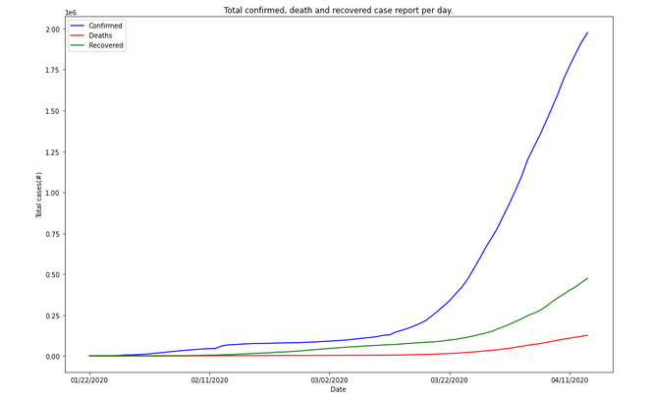

Slide 19
Conclusions
Our model tells us that the COVID-19 epidemic grow in the World Between 22 mars and 11 April, if the current trend is maintained over time. Regional differences apart, we have to consider that any new external factor can change the effective trend of the epidemic. The current model can not take into account unexpected changes in the system, such as the gradual loosening of lockdown restrictions, or the effects of warmer temperature over the virus spread. Finally This Model still tracking the Virus But the dataset must be refreshed every time .

Slide 20
Thanks For Your Time

